Slide 1


MEDITECH Expanse
Orders
Web Based HER
MUST be viewed as a Slide Show

Slide 2

Contents
Headers
Introduction
Enter Order Screen
A Basic Order
A Medication Order
Order Sets
Transfer Routine
Slide 3
Slide 5
Slide 8
Slide 14
Slide 22
Slide 35
Slide 51

Slide 3
Headers

Slide 4
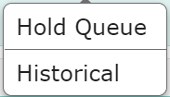
There are 6 headers (2 hidden)
Current – Active Orders
Enter – Entering Orders/Order Sets
Reconcile – Admission Med Reconciliation
  By Admitting/Responsible Provider
Transfer – Routine That Creates Pending Orders
  When Changing Level of Care
  By Admitting/Responsible Provider
Hidden Headers
  Hold Queue – Orders for future visit
  Historical – All orders (Active/Completed/Cancelled/etc.)

Slide 5
Introduction
To Entering Orders

Slide 6
Orders
This is a more detailed look at entering orders in Expanse
There is a preferred display (Favorites by Category)
  Setting up favorites is key to time saving for orders

Slide 7

Recap
Entering Orders
Expanse combined Orders, Medications (& Fluids) and Order Sets into a single search
The Favorites/Orders/Sets buttons are display options
“Process Orders” serves no real purpose (adds clicks)
  This was basic needed functionality for 6.15 and Expanse Desktop

Slide 8
Enter Order Screen
Headers and Options on Enter Orders Screen

Slide 9
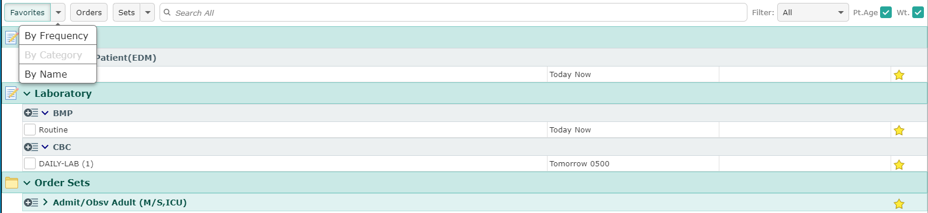
Favorites
Favorites (By Category) – Grey indicates already selected
As more orders are made favorites, they are organized into more categories
Yellow stars indicate favorites (White – not favorites)
  Clicking the star changes the status

Slide 10
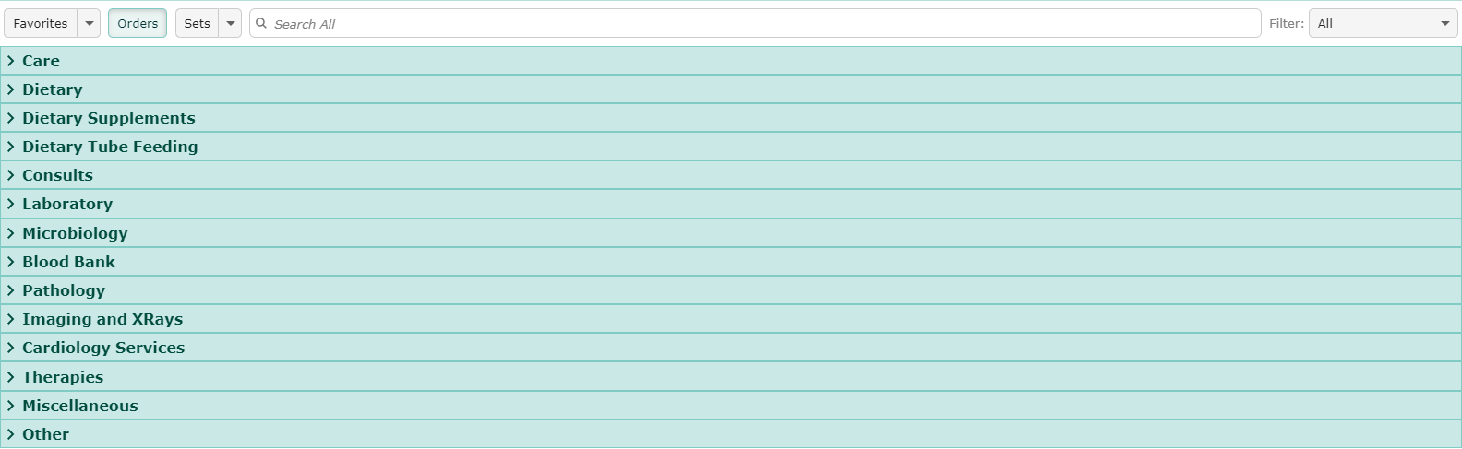
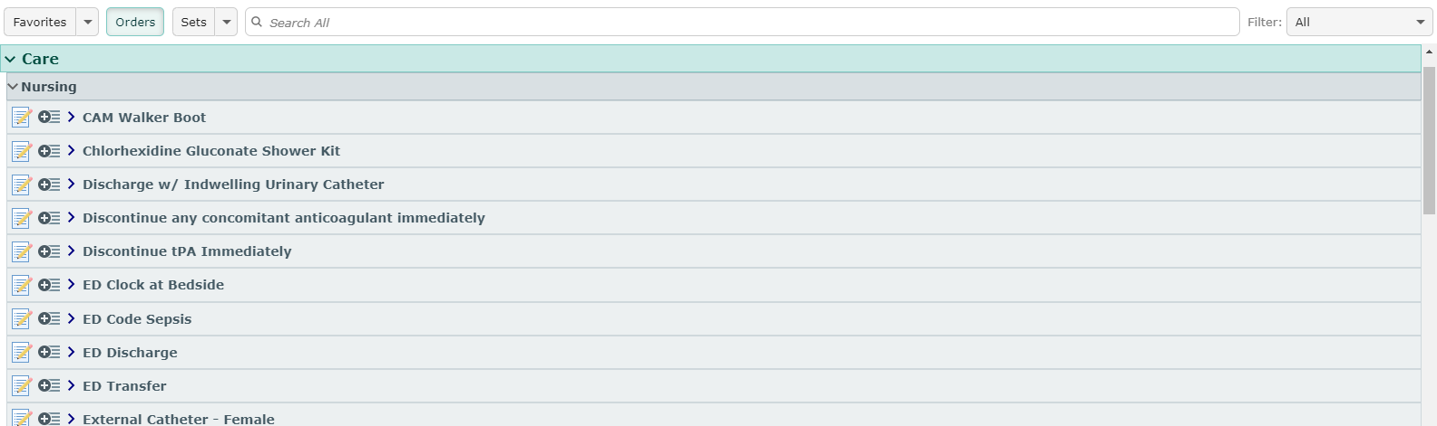
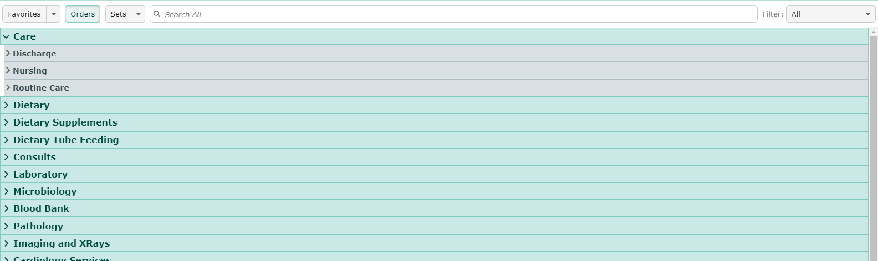
Orders View
*Rarely useful*
A more difficult way to find orders
Clicking a category expands the category
Clicking on a subcategory expands the subcategory
Finally the orders are revealed and selectable
  Scroll to find

Slide 11
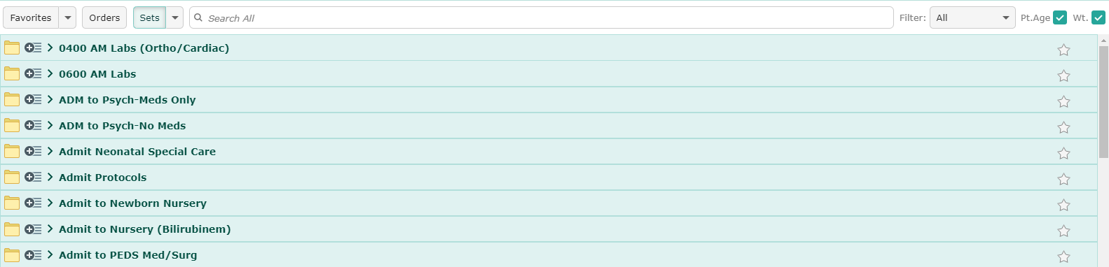
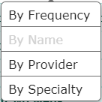
Sets View
Primary use is to find and set favorites
By Frequency
  Useful after a period of time using Expanse Web
    Find (and make favorites) all frequently used

Slide 12
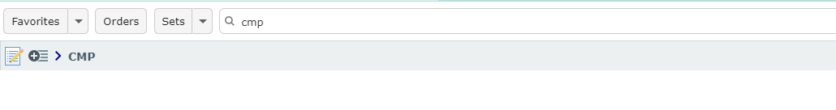
Search
Type into the search box
  Results will display after brief pause (Don’t use “Enter”)
Indicator of order type
Add to Process orders **Not Recommended**
Open options – click anywhere on the indicated bar

Slide 13
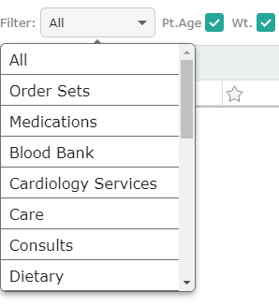
Filter Options
Rarely Changed
Order Type/Category may be selected
  “All” defaults
Patient Age filter
  Defaulted to On
  Age defined orders
    will appear as appropriate
Weight filter
  Defaulted to On
  Weight defined orders
    will appear as appropriate

Slide 14
A Basic order
Options
Submit and Sign

Slide 15
Selecting Frequencies
The Frequency is the first selection for non-medications
STAT – Today and now
  No options if made a Favorite
Routine – Defaults to today and now (may be changed)
  No options if made a Favorite
Daily-Lab – Defaults to next Scheduled Day/time
  Series type
    Defaults to quantity of 1 (may be changed)
  No options if made a favorite

Slide 16
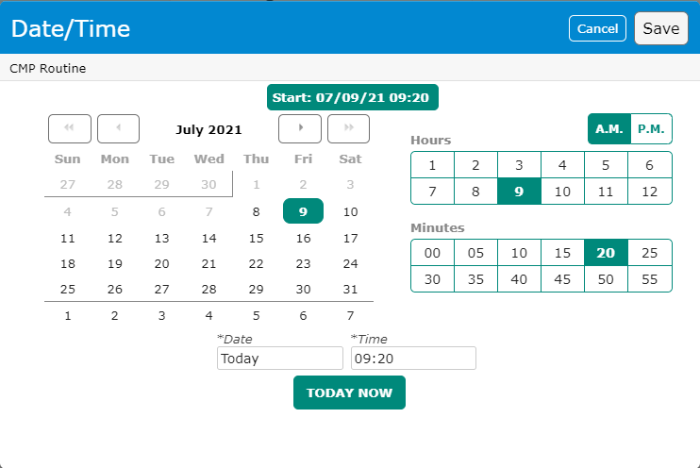
Date/Time Selection
Clicking on the Date/Time field opens a popup box
Date section
Hour section (with AM/PM selection)
Minutes (5 minute increments)
“Today Now” button

Slide 17
Date/Time Selection
Clicking on the Date/Time field opens a popup box
Date section
Hour section (with AM/PM selection)
Minutes (5 minute increments)
“Today Now” button

Slide 18
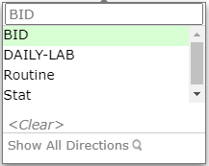
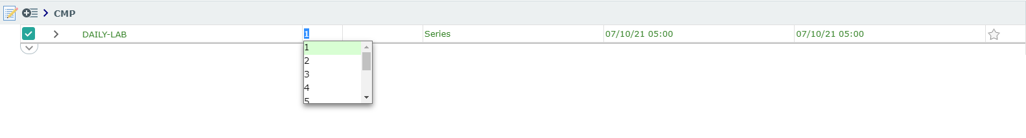
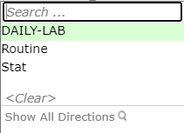
Series Options
Clicking the series #, allows for an increase in the number of sequential orders
Clicking the “Daily” Frequency
  Allows to search for other frequencies
  Type BID and BID option is available
    Q6H, Q6HR, Etc

Slide 19
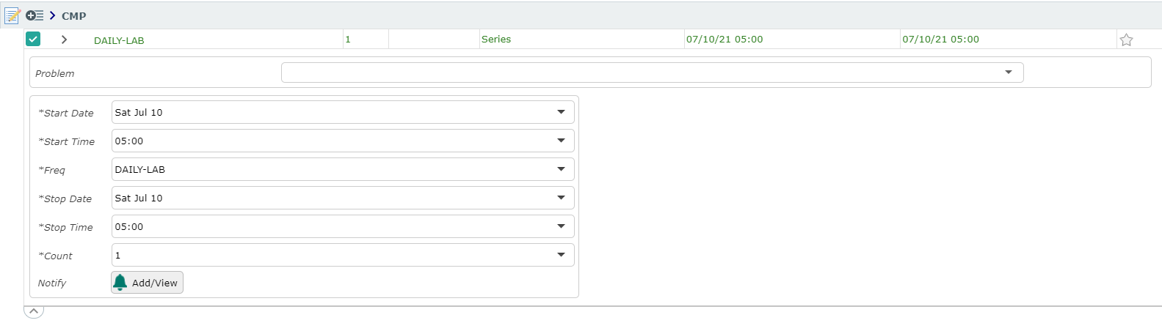
Details Dropdown
Click the Details Dropdown to expand the details section
Details section appears (Fields vary based on order)
Problem – only complete if required (rare)
Rarely – Required fields are here
  More useful fields with medication orders
Click Details Dropdown (reverse) to collapse the details section

Slide 20
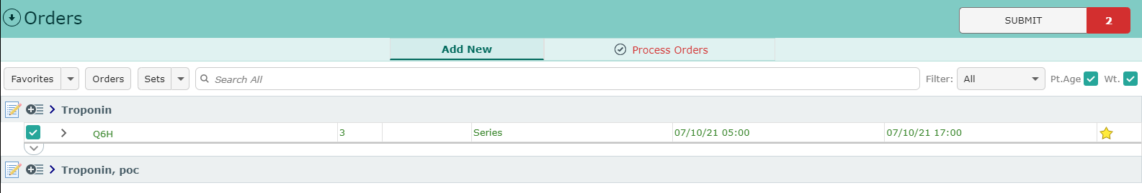
Order Screen Features
On selecting “Enter” the headers are hidden to expand the working area
Clicking the down arrow reveals the headers
“Process Orders” header available once orders have been selected
  Only useful to edit previously selected orders
“Submit” – displays total # of orders selected
  Functions like “Shopping Cart” on Amazon

Slide 21
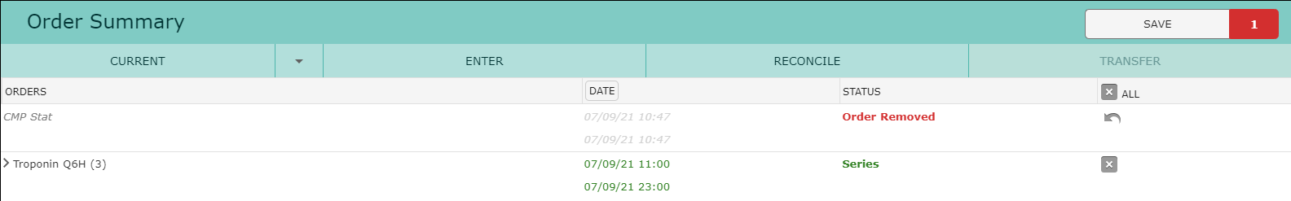
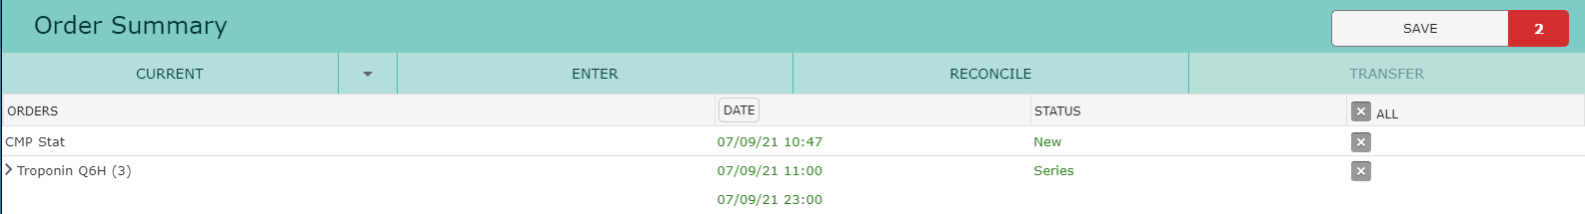

Submit Screen
All selected orders display for review
Any (or all) orders may be deselected
Removed orders may be reinstated
  Note the order count decreased to 1
Clicking “Save” allows you to enter your sign PIN

Slide 22
A Medication Order
Options
Features

Slide 23
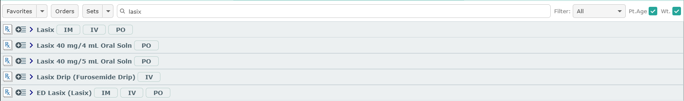
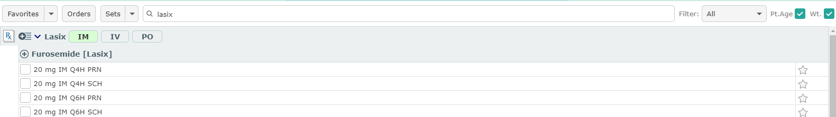
Medication Orders
Searching for Lasix (generic/brand names are both searchable)
IM/IV/PO options
  Displays only the options selected
  Clicking outside buttons displays ALL options
Solutions (with concentrations)
Drips are clearly indicated
ED specific Medications always start with “ED”

Slide 24
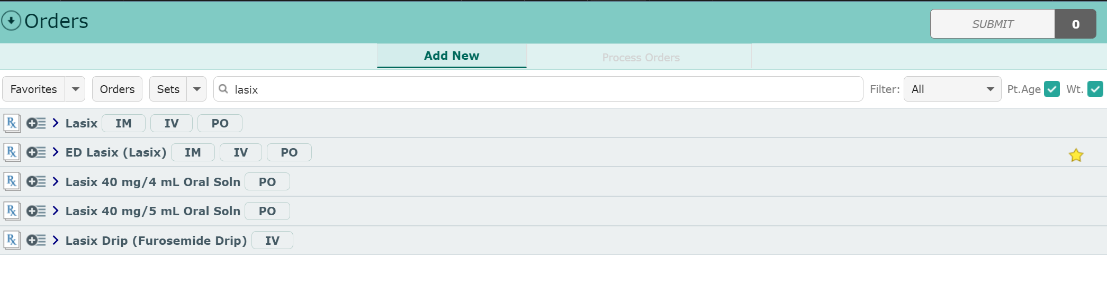
Medication Orders
ED specific rule
All your Medication Favorites should be the “ED” version
  Pharmacy has built these specifically for the ED

Slide 25
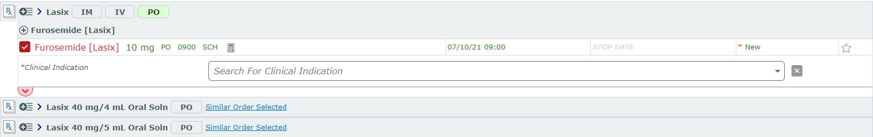
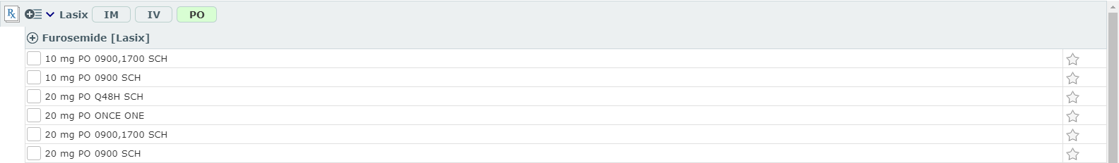
Medication Orders
Lasix PO has been selected with 10/20 mg options displaying
Dose/Route/Frequency are selected from list
  Scheduled/Once/PRN
  If scheduled, times display
Choosing “10 mg PO 0900 SCH”
  Red (Check Box/Name/Details Drop arrow) flag required Information
  “*” Indicates what details are required

Slide 26
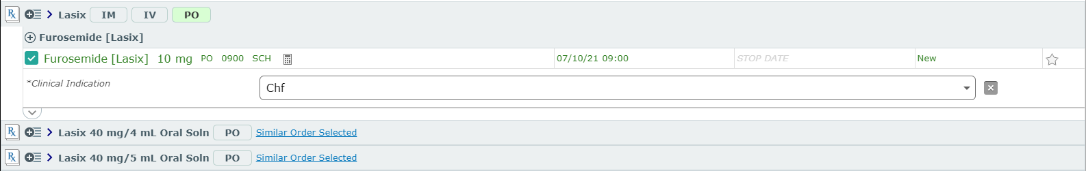
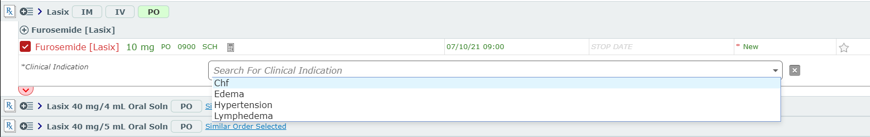
Medication Orders
Clinical Indications
  Can be selected from drop down
    Click anywhere in field for drop down
  Can be typed/dictated
    List will display if entry not on list
Green – All required fields completed
Note similar orders are flagged

Slide 27
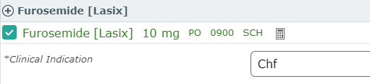
Medication Orders
Editing from the Order screen
  *usually preferred to select the correct options initially (if available)
Dose can be edited (20 mg = 2 tabs; 5 mg = ½ tab)
Route can be edited (If appropriate)
Frequency can be edited
One/PRN/SCH/STAT options
  Option must make sense with selected Frequency
Dose Calculator – For weight-based meds

Slide 28
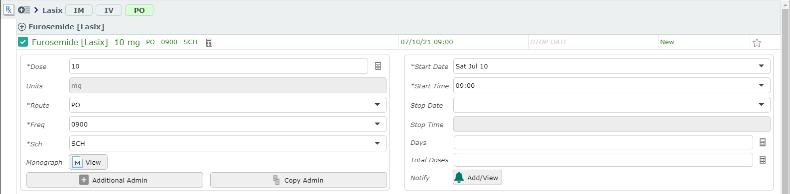
Medication Orders
Details View
Medication specific details may be edited
Start day/time along with STOP parameters may be edited

Slide 29
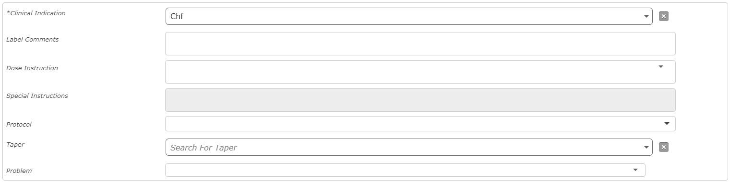
Medication Orders
Details View
Below the order details/Start Stop section
Label Comments – Appear on the Medication Label
Dose Instructions – Communication to Pharmacy
  Details you may not be able to specify elsewhere
Special Instructions – Not always available, similar to Dose Inst
Protocol – Hold Parameters/Drips etc.
Taper – Pre-built tapers (Steroids/CIWA/C-Diff)

Slide 30


Medication Order
Flags
Red Triangle – Conflict warning
  Conflict will need to be addressed
    if ordered
Protocol
  BP Hold Parameters in this case
  May be edited in Details section after medication is selected
Instructions
  Label Comment and/or Special Instructions pre-filled

Slide 31
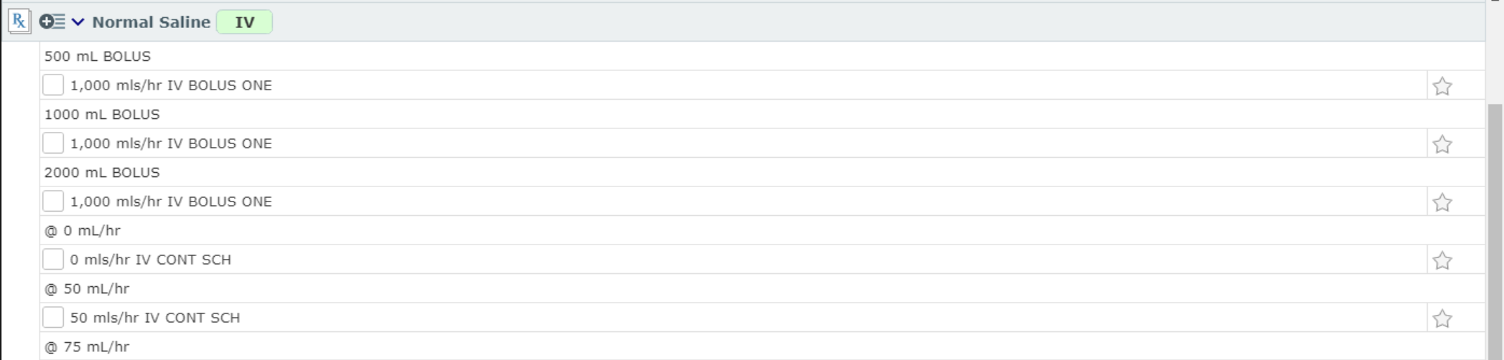
Medication Orders
IV Fluids
Meditech continues to treat IV Fluids as Medications, though the distinction blurs in Expanse
Bolus order include the volume and the rate
Continuous Drips may include the rate
  Or not

Slide 32
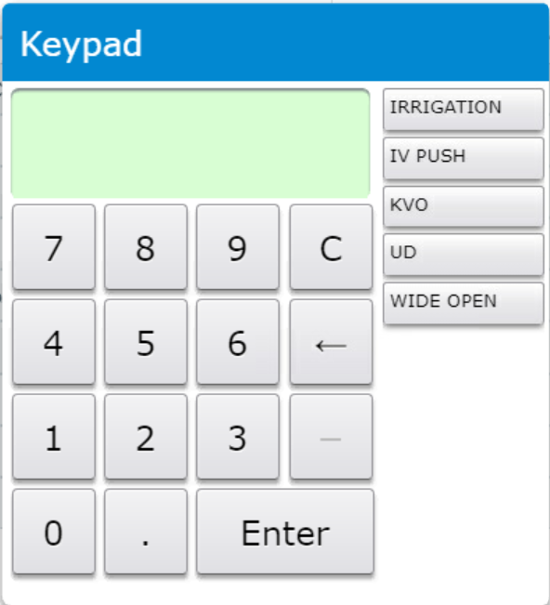
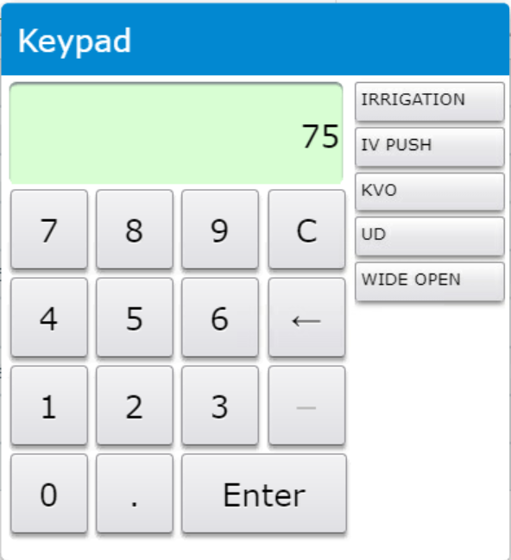
Medication Orders
IV Fluids
A Continuous IV without a predefined rate
Rate is required
Type or click to enter the desired rate
Optional word entries available

Slide 33
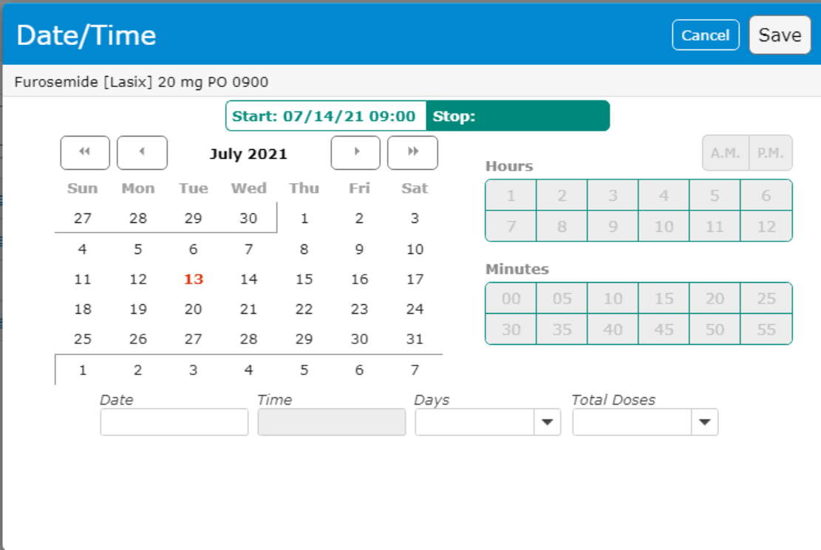
Medication Orders
Stop Date
Stop Date options
Medications
  Stop Date
  Options are
    Date/Time (Time available once date selected)
    # of Days
    # of Doses

Slide 34
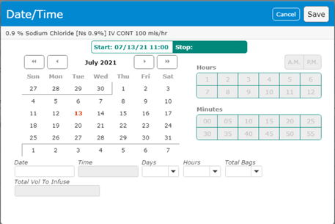
Medication Orders
Stop Date
IV Solutions
  Stop Date
  Options are
    Date/Time (Time available once date selected)
    # of Days
    # of Hours
    # of Bags

Slide 35
Order sets

Slide 36
Order Sets
Order Sets are available under Favorites, Under Sets and via search
We will be reviewing the “Admit/Obsv Adult (M/S, ICU) Order Set” but focusing on specific detail
With a few exceptions, This is the required Order Set for admitting a patient
  Observation/Post Partum and a few Surgical sets are stand alone’s
Modules, are usually diagnosis specific and compliment the admission set with specific orders for that diagnosis
There are many other order set types

Slide 37
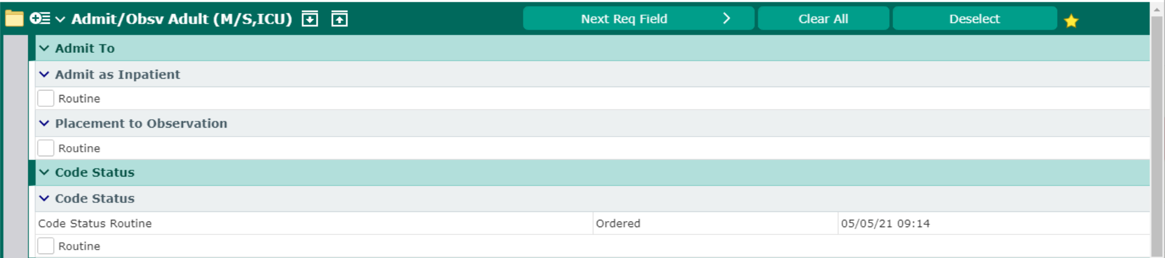
Order Sets
The file folder indicates this is an order set
Deselect (toggles with Pre-Selected)
  Deselects pre-checked orders
  Useful when you are using one or two orders on an Order Set
Clear All – Deselects pre-checked and your selected orders
Next Req Field – Moves you through required fields
  When accepting defaults
  OR Searching for missing fields

Slide 38
Order Sets
“Admit as Inpatient” vs “Placement to Observation”
  One must be completed to “Admit” a patient
    Admit or Observation

Slide 39
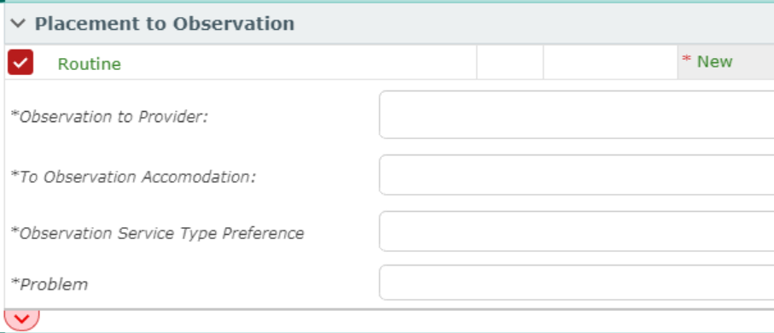
Order Sets
“Admit as Inpatient” vs “Placement to Observation”
  One must be completed to Admit a patient
Placement to Observation
  The Assigned Admitting Provider (Yourself if privileges)
  Accommodation type (Medical/Surgical)
  Service Type (Medical/Telelmetry/Surgical/Peds etc.)
  Problem – search ICD-10 problems

Slide 40
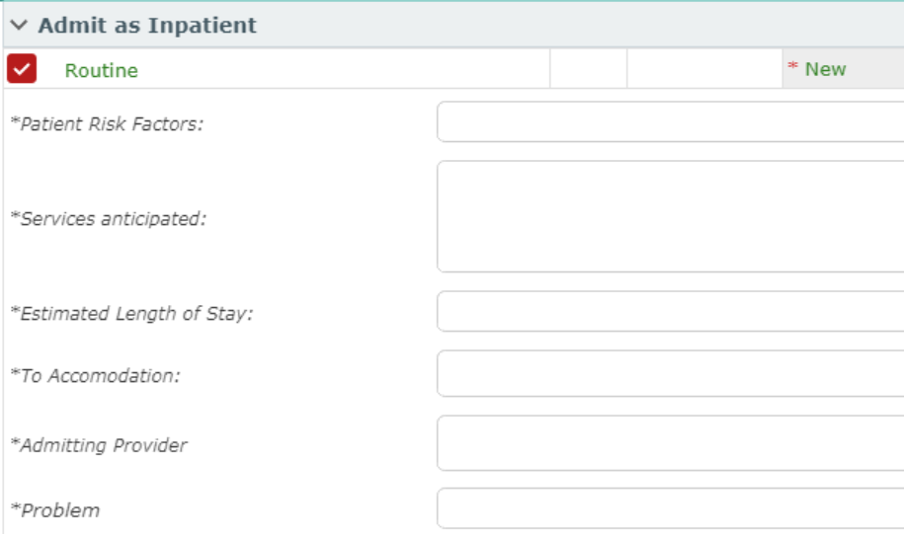
Order Sets
Admit as Inpatient
  More fields to justify Admission
  Risk Factors – Free Text – Justify Admission with Risk
  Services Anticipated – Free Text – Justify Admission with Services
  Length of Stay Estimate
  Accommodation (Medical/Telelmetry/Surgical/Peds etc.)
  Admitting Provider
  Problem (ICD-10)

Slide 41
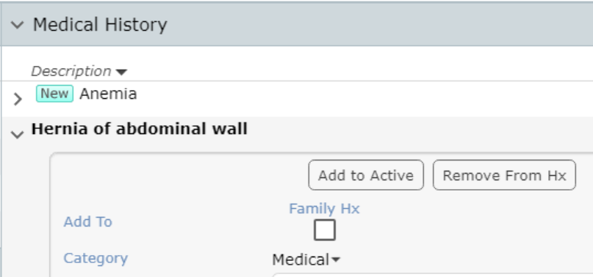
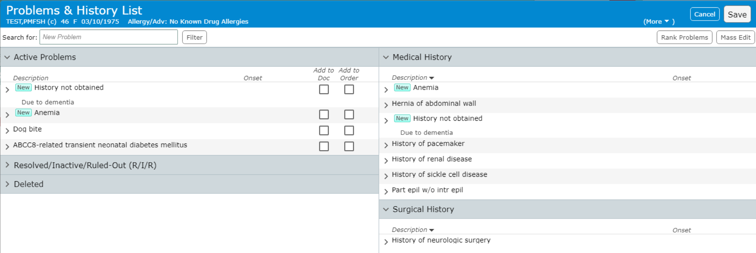
Order Sets
Selecting Problems
These only go to Registration (They will only include 1-2)
Add Existing Active Problems to Order
Medical History Problems can be made Active
  Then added to order
New Problems can be searched for

Slide 42
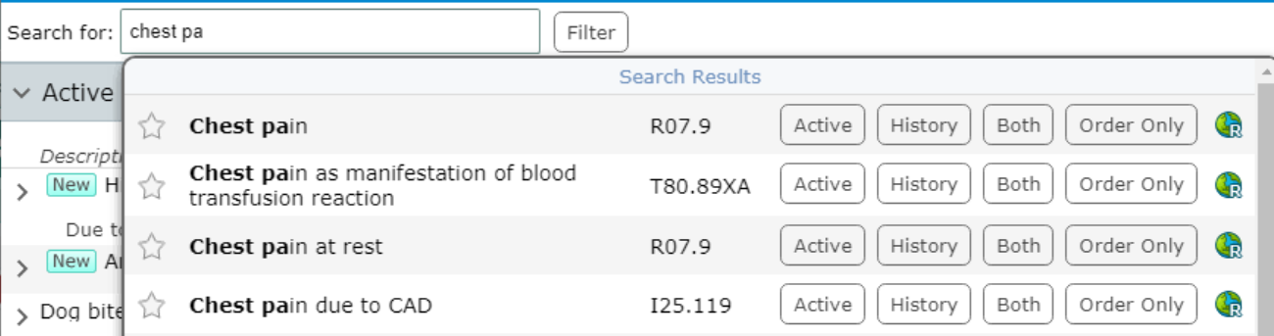
Order Sets
Type a partial or full name
  Pause, allow the search to occur (“Enter” not needed)
Select the *Basic* diagnosis
  Specificity is handled more appropriately within documentation
Order Only – Adds to Active problems & ✓”s Add to Order
Active/History/Both – Covered extensively in “Documents”

Slide 43
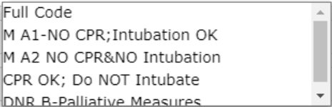
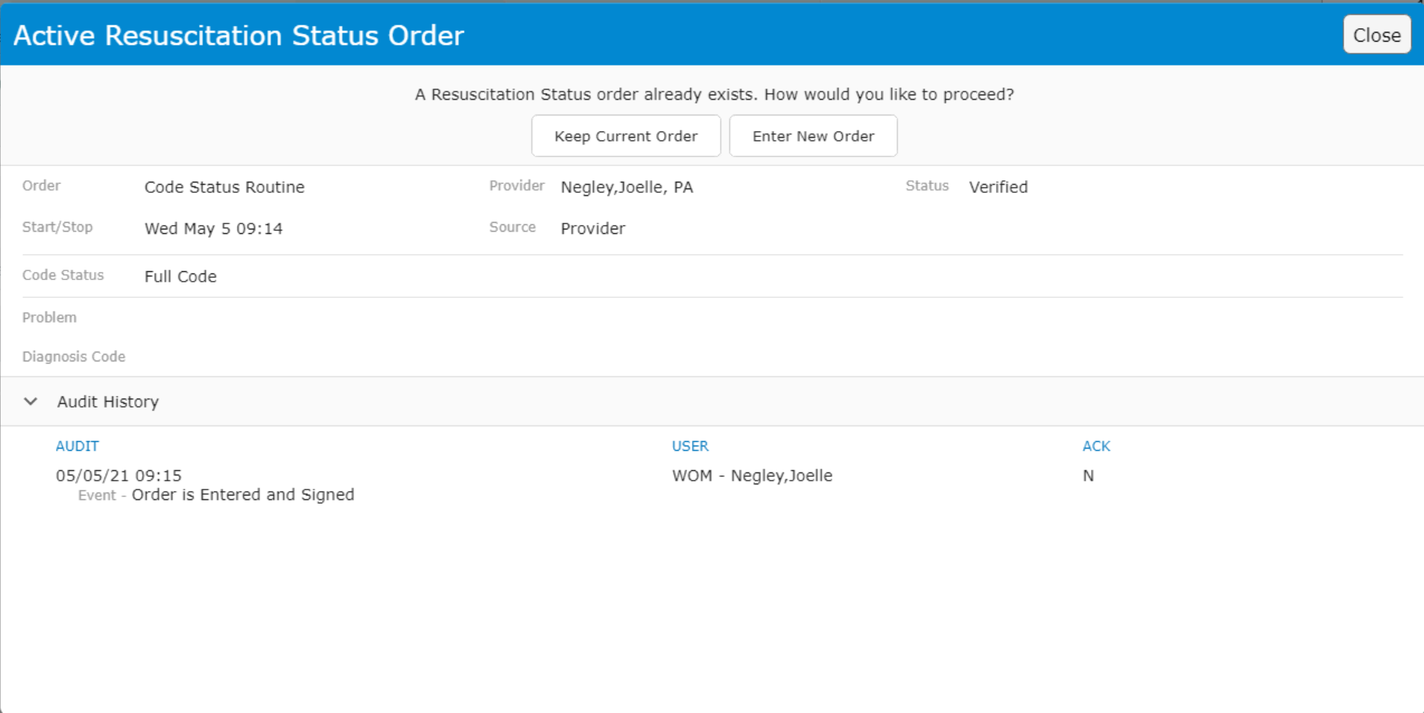
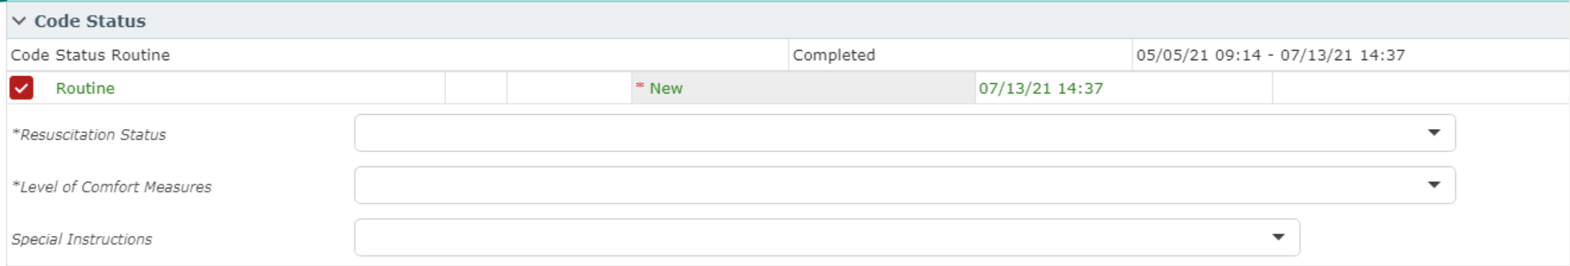
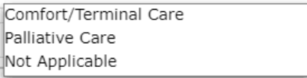
Order Sets
Code Status
If an existing Resuscitation Status order exists
  You must choose to keep or change by entering a new order
  **Any entered Code Status order will inactivate/complete previous
Resuscitation Status
Level of Comfort Measures

Slide 44
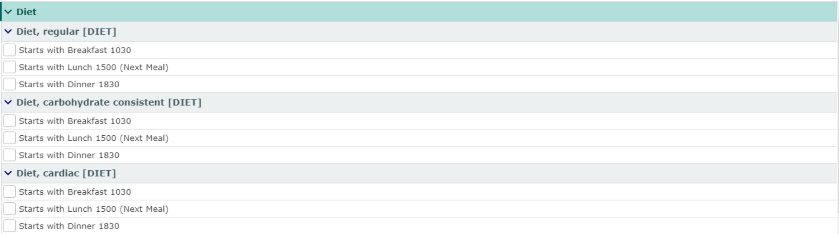
Order Sets
Diet
As with Code Status, only one Active diet order can exist
  Can have staggered start times (Reg NPO Clear Liq)
3 choices for starting meal
  “Next Meal” indicates preferred choice if not NPO
  Time = Last time to serve that meal (time “next meal” changes)
Carbohydrate consistent
= Diabetic Diet
NO Calorie selection options

Slide 45
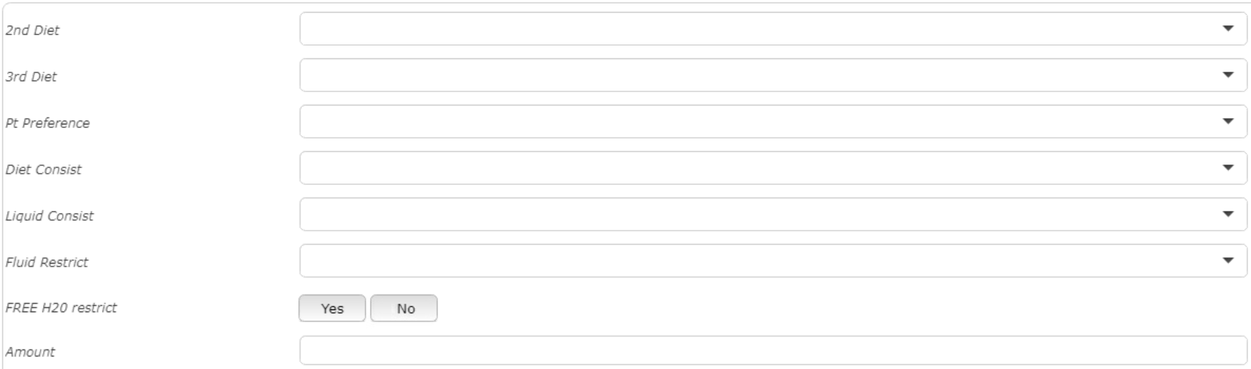
Order Sets
Diet

Slide 46
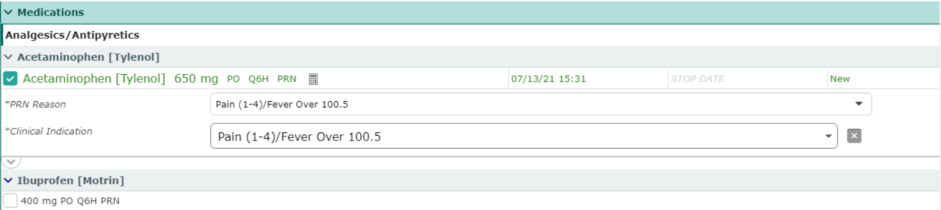
Order Sets
Medication Orders within

Slide 47
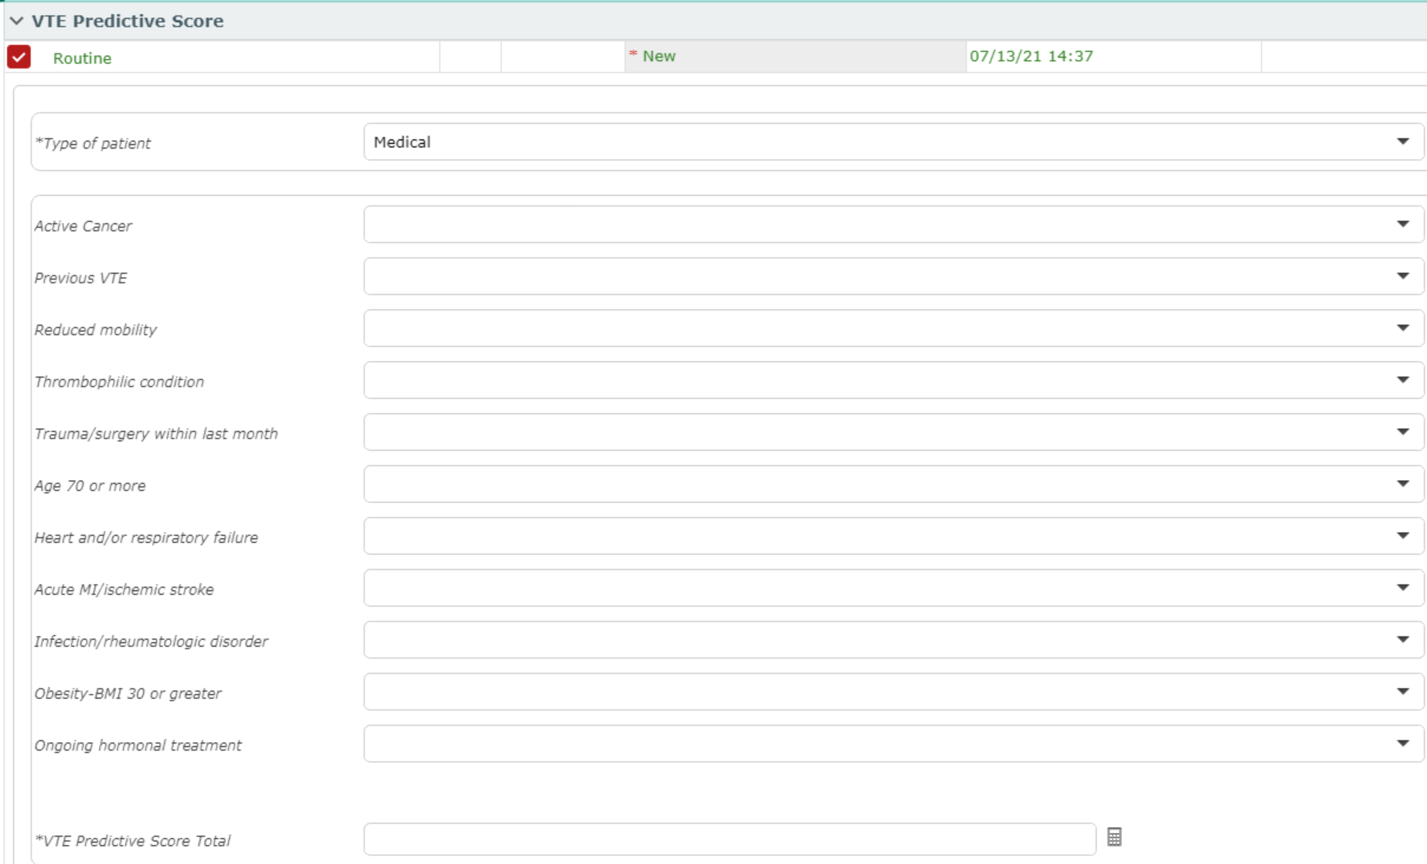
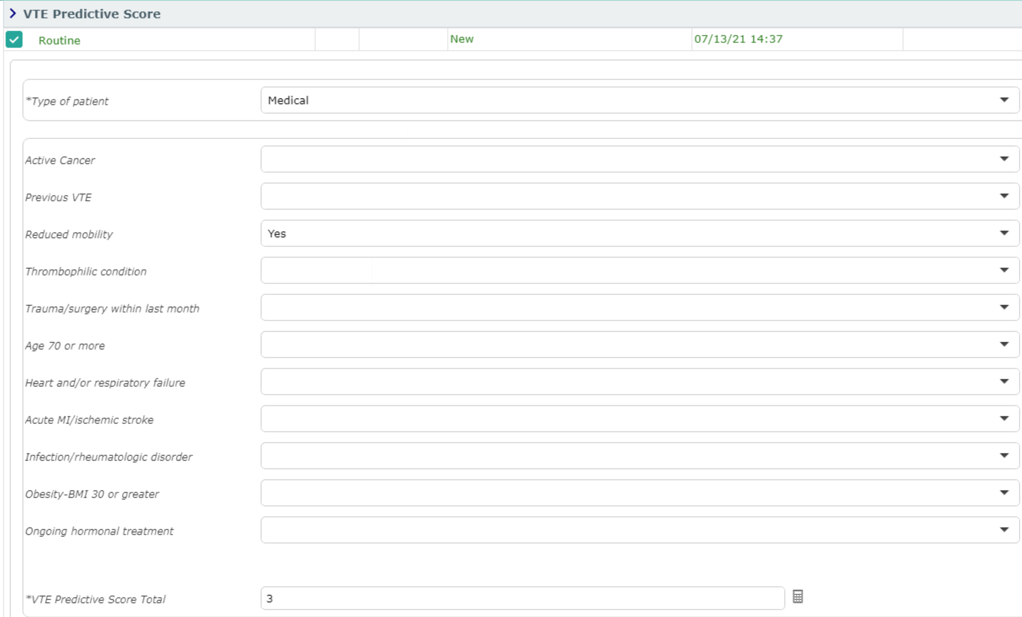
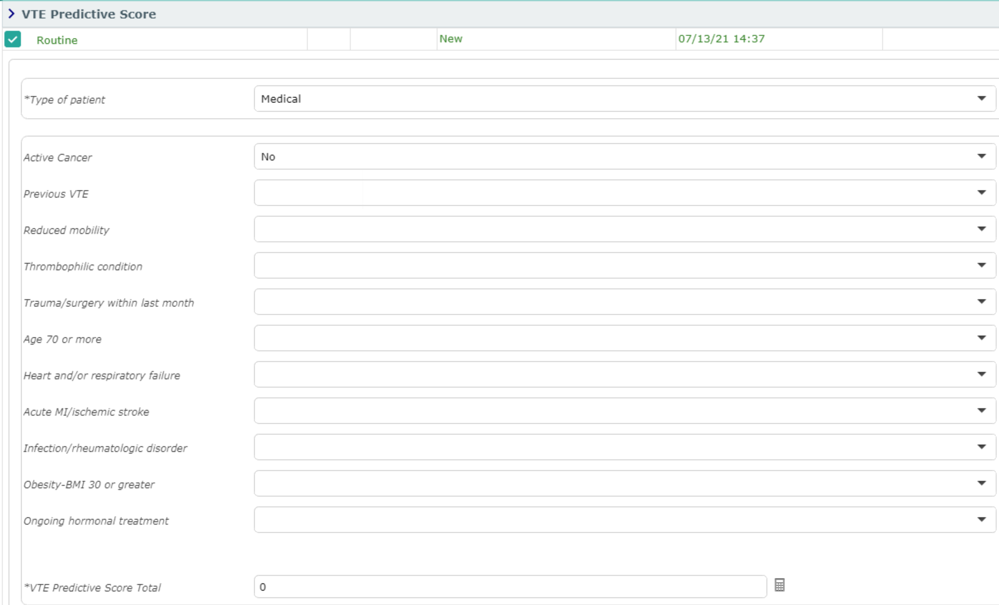
Order Sets
VTE Predictive Score
The VTE Predictive Score is pre-selected & Required
Expand the order to complete the details
Medical (Shown) or Surgical patient types
*Answer All “Yes”, BUT Only Yes’s
  Answers scored
If No Yes – 1 “No”
  Scores 0

Slide 48
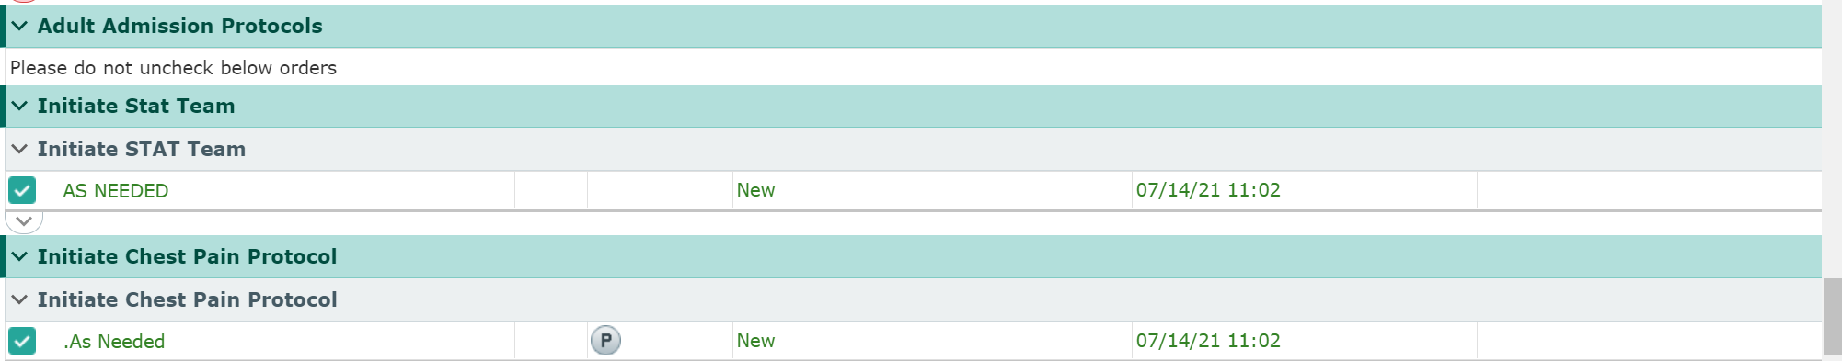
Order Sets
Adult Admission Protocols
Adult Admission Protocols are orders that allow Nurses to initial care under emergent situations via established protocols
Please do NOT uncheck the orders
  Call STAT Team
  Chest Pain Protocol
  Hypoglycemia Protocol
  Narcan
  C-Diff Protocol
  Bladder Scan Protocol

Slide 49
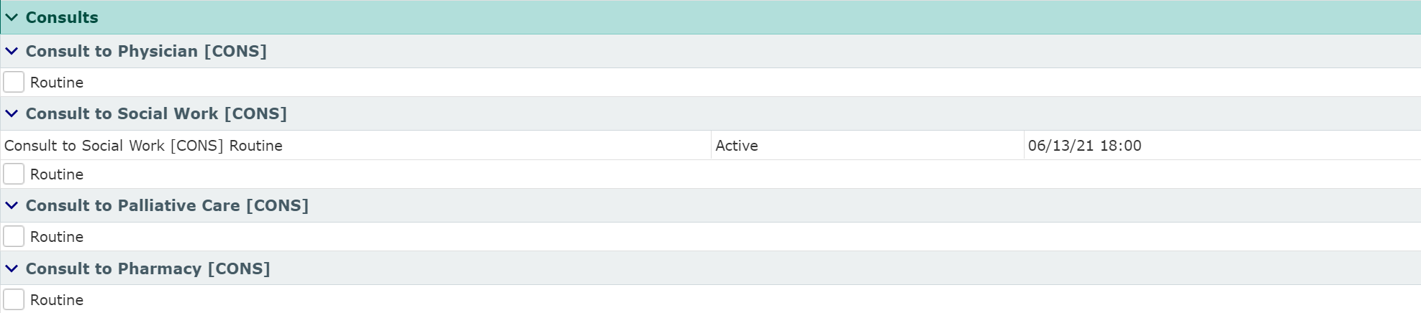



Order Sets
Lab Orders
Radiology Orders
Diagnostic Tests
Consultations

Slide 50
Order Sets
This Order Set was an Admission Set
  A more complex/complete Order Set
Other Order sets may be
  Modules
    Diagnosis specific
  Medication Specific
    i.e. Insulin drip/Heparin
  Department Specific
    i.e. ED order sets are specific to that department
      Only to be used in the ED
    OB/Surgical/Ped/Ortho
  Various requested sets

Slide 51
Transfer routine
Creating Pending Orders When Changing Level of Care

Slide 52
Transfer Routine
Used when moving patients to different levels of care
  ED ➢ Inpatient, PACU ➢ Inpatient, Medical ➢ ICU, etc.
Creates “Pending” orders that are activated by nurse on receiving unit
The Routine consists of 4 parts
  The Transfer Order – Only goes to Registration
  Existing Orders – Stop/continue
  Admission Medication Reconciliation
  New orders
“Now”
  Cancelled Orders – Can be stopped “now” which cancels the order under Current Orders
  New Orders – Moves to order to Current Orders (Will continue on transfer)
    Recommended to verbally tell nurse that new order was entered, and you would like it done/initiated before transfer

Slide 53



Transfer Routine
The Transfer Order
To Exit from the Transfer Routine without saving
The Transfer Order
  To Accommodation (Should match Admission/Obs Order)
  To Registration Status (Should match Admission/Obs Order)
  Problem

Slide 54


Transfer Routine
Pop-Up
Reflex Order if Telemetry Accommodation Chosen (Required)
Telemetry Admission Guidelines
  Additional Information required
    Based on Guideline chosen

Slide 55

Transfer Routine
The Transfer Order - Problem
Same rules as Admission Order discussed under order Sets
Click Check Box to add problem to order
Enter Order if needed into Active Problem List

Slide 56

Transfer Routine
Existing Orders
Option to Continue OR
Stop Orders
By Order OR
Section/Order Type
“Now” – Only functions when orders are stopped
  Stops them under Current Orders when saved

Slide 57
Transfer Routine
Existing Orders
Outpatient Orders should usually be stopped
Exceptions
  Drips/Titratrations
  Sepsis Orders
    Blood Cultures/Lactate
  Consultations (If Appropriate)
  Others if assessed as appropriate

Slide 58

Transfer Routine
Admission Med Reconciliation
“Reviewed” – Postpones Home Meds if Home Meds incomplete

Slide 59

Transfer Routine
Admission Med Reconciliation
Home Meds
Continue All/Hold All
  Option to Process all orders the same way
Continue/Hold each Medication individually
Additional Options
  “Pt’s Own”
  “Notify”
    Only displays if Medication entered incorrectly

Slide 60

Transfer Routine
Admission Med Reconciliation
Continued medication
  Duplicates as a “Linked” Visit Med
  Clinical Indication Required
Hold Med

Slide 61

Transfer Routine
Admission Med Reconciliation
Visit medications (Required)
Continue All/Stop All Option
Continue/Stop individual Orders
  Continue only recommended for Drips/Titrations

Slide 62


Transfer Routine
New Orders
Add New
“Enter” screen appears
  Select Order Sets and Orders as Appropriate
  Admission Order Set covered in Order Sets

Slide 63


Transfer Routine
Resolve Conflicts
Override
  Reasons may or may not be required
Erase
  If you change your mind and want to cancel order

Slide 64

Transfer Routine
New Orders
Save and PIN your Orders
Click to answer any missed questions

Slide 65

Transfer Routine
New Orders Now display at the top
STAT Orders automatically “Now”
Admit/Observation Orders automatically “Now”
Submit & PIN to finish

Slide 66
Transfer Routine
If Telemetry location chosen
  Cardiac Monitor order moves from “Transfer Reflex” to “Transfer Orders”
  Transfer Orders must be Submitted/Saved a second time
    To save the Cardiac Monitor order

Slide 67

Thank You
You should have been scheduled for 1 on 1 training
Please call (410)535-8260 or email glenn.heaney@calverthealthmed.org if you have questions

